Slide 2
Vendor Open House
School District of Lee County
Procurement Services
December 19, 2019

Slide 3
Schedule/Agenda
District Information
Non-Construction Solicitations
Construction Solicitations
Match Maker

Slide 4
Procurement Services
Our Mission
Purchase the highest quality goods and services at the best value while protecting the integrity of district funds and adhering to policies and procedures. We will maintain fair and equitable relationships with all business partners, provide quality customer service, and contribute to the district's mission: to ensure that each student achieves his/her highest personal potential.
Procurement Services is within the Business Services Division
DISTRICT
https://www.leeschools.net/our_district/departments/business_services

Slide 5
Procurement Services Staff
Fredrick B. Ross – Director of Procurement Services
Tracey Adams – Procurement Coordinator
Rich Cowie – Procurement Agent
Jim Carrasco – Procurement Agent
Loire Nein – Procurement Agent
Doug Gupton – Procurement Agent
Edith Stiller– Procurement Agent
Joni Al-Shabibi – Procurement Agent
Amy Naranjo – Procurement Analyst
Lori Spiczka – Procurement Analyst
Zoraida Cardenas – Procurement Specialist
DISTRICT

Slide 6
District Departments Served
Procurement Services
Schools
(96) Total Schools
(45) Elementary Schools
(16) Middle Schools
(14) High Schools
(17) Special Education Centers & Vocational / Technical Colleges
(4) K-8th Schools
93,167 Students
5,500 Teachers
Departments
Information Systems
Food & Nutrition Services
Transportation
Travel over 12.6 million miles each school year
Over 728 school buses
Maintenance
13.4 million square feet
Construction
4 New Schools in Process
DISTRICT

Slide 8
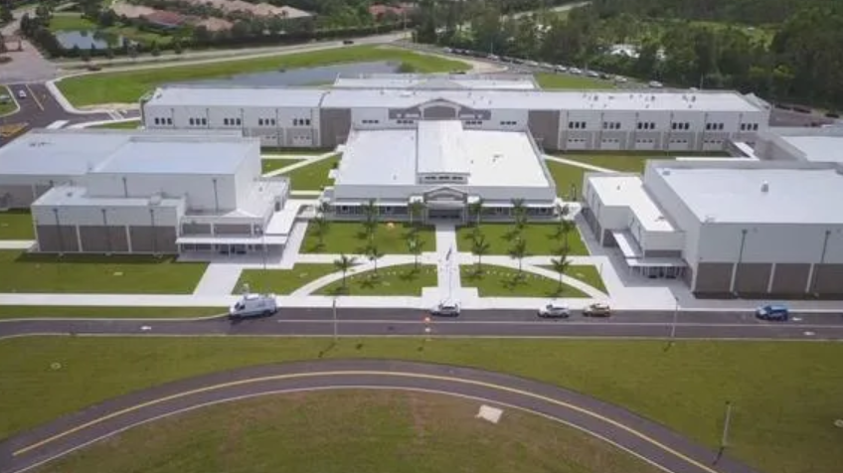

Slide 9
Vendor Registration
New vendors must complete a New Vendor Registration Form and return it to the Procurement Services Department.
Current vendors should verify annually that all registration information is up to date.
Vendors should regularly monitor the Procurement website for new solicitations of interest to their organization.
The District attempts to contact registered vendors as solicitations are released, however no guarantee is made or implied that the District will notify vendors of upcoming or current solicitations.
Previously awarded bids are located at:
www.leeschools.net/awarded-bids, and
www.leeschools.net/awarded-construction-solicitations
Construction related solicitations that are governed by Florida Statues Chapter 287 are also issued by the Procurement Services Department. Information on these items is located at:
www.leeschools.net/construction-solicitations
DISTRICT

Slide 10
Vendor Fingerprinting / Background Screening
Vendor must comply with all requirements of Sections 1012.32 and 1012.465, 1012.467 and 1012.468 Florida Statutes
Required prior to performing work
Vendor pays for screening fees
Vendor provides list of its employees who have completed background screening
Vendor must notify SDLC if a badged employee is convicted of a crime
DISTRICT
A Florida Universal School District badge is accepted
by all Florida School Districts for 5 years

Slide 11
Where do I find bids?
District purchases over $50,000 requires a formal solicitation
Bid, ITN, RFP, RFQ
Formal solicitations are advertised on these web pages:
Non-Construction Solicitations
www.leeschools.net/active-solicitations
Construction Solicitations
www.leeschools.net/construction-solicitations
DISTRICT

Slide 12
Solicitation Types – Over $50K
Invitation to Bid (ITB): used when the District is able to define the specifications. The award is made to the lowest responsive, responsible bidder.
Request for Proposal (RFP): used when the District solicits the business community for solutions to a particular set of requirements. An RFP has award criteria that includes price, however price is not the only factor considered.
Invitation to Negotiate (ITN): utilized to negotiate the scope of services and pricing in order to obtain best value.
Request for Qualifications (RFQ): used to solicit construction related services governed by Florida Statutes Chapter 287.055.
DISTRICT
Laws allow the District to make some purchases without a solicitation.

Slide 13
Bid Openings
NON
CONSTRUCTION
All formal bid openings are public
Bids are not awarded during the opening
In compliance with Florida Statutes, bid prices are not disclosed at the bid opening
All submittals are subject to evaluation by the District before a recommendation of an award is presented to the School Board
All bids and proposals are subject to the Public Records Law

Slide 14
Bid Life Cycle
Competitive Solicitation (ITB/ITN)
Board Approval of Award
Contract Period Annual Board Expenditure Approvals
Contract Renewal Period Board Approvals
Preparation for new Competitive Solicitation
NON
CONSTRUCTION

Slide 15
Upcoming Solicitations
NON
CONSTRUCTION
School Bus Seat Covers - Bid Opening 01.10.20
Two Way Radio Equipment and Services - Bid Opening 01.16.20
Rental of Spot Coolers and Dehumidifiers - Expires 04.27.20
Financial Advisor Services - Expires 05.25.20
Irrigation Repair and Replacement - Expires 08.24.20
Benefits Consulting and Actuarial Services - Expires 10.01.20
Cafeteria Hood Ventilation Systems (Clean/Inspect/Repair) -Expires 11.16.20
Water Based Fire Systems Repairs. Expires 02.08.21

Slide 16
Expanding Your Business
NON
CONSTRUCTION
Awarded vendors may sell their products and services to other government agencies through the bid piggyback process
If you won an award, this is a simple way to grow your business!!!!!!!
It makes Procurement Staff happy ☺ ☺ ☺
Notify each agency’s Purchasing Department of the bid you were awarded, a description of your products/services, and your contact information
This collaborative purchasing method increases the operating efficiency of multiple purchasing agencies and offers vendors the opportunity to expand their business base.

Slide 17
Construction Solicitations
The Procurement Services solicits contracts for construction-related services
Continuing Contracts awarded in alignment with the Consultants’ Competitive Negotiation Act (CCNA) (section 287.055, Florida Statutes).
Architect
Building Official
Civil Engineering
Mechanical, Electrical, and Plumbing (MEP) Engineering
General Contractor less than $200K and $200K - $2 Million
Bonding required only for projects $200K - $2 Million
Roof Consultant
Providers of construction services in accordance with the purchasing model known as Construction Manager at Risk (CMAR).
Guaranteed maximum price (GMP)
Construction services include and are not limited to the process of building, altering, repairing, improving, or demolishing any structure or building, or other improvements including roadways, utilities, and facility site work.
Providers of other construction related services
CONSTRUCTION

Slide 18
Advertising & Opening
Vendor list developed prior to advertising
The District attempts to contact registered
Legal notice advertised with Fort Myers News-Press
Required by law
RFQ publicly posted on the Procurement website.
Contractors should regularly visit https://www.leeschools.net/procurement
All publications will specify the:
Date
Time
Location of the mandatory pre-submission meeting (if any)
Responses due date
Responses to the RFQ will be publicly opened at the date and time specified in the RFQ or any addenda.
CONSTRUCTION

Slide 19
RFQ Evaluation Process
Each Solicitation has a defined group who will evaluate responses
Responses are publicly scored & a shortlist of vendors is selected for presentations
Presentations and Interviews are conducted
Public scoring of presentations occurs
Board approves ranking
Negotiation of each contract occurs
CONSTRUCTION

Slide 20
Upcoming Construction Solicitations
CONSTRUCTION
https://www.leeschools.net/our_district/change_for_change/projected_projects
https://www.leeschools.net/cms/One.aspx?portalId=676305&pageId=1390497

Slide 21
Subcontracting on District Projects
Construction Projects awarded to Construction Management (CM) firms
CM Firms solicit bids from qualified subcontractors to develop their Guaranteed Maximum Price (GMP)
Subcontractors must bid directly with the awarded CM for each major project
Awarded CMs are posted on the Procurement website
Subcontractors must monitor Procurement website
District Project Manager monitors the CM bidding process
Attend bid openings
Review Subcontractor Qualifications and Licenses
Working to implement CM advertisement of bids on District website
CONSTRUCTION

Slide 22
Current General Contractors
Chris-Tel Construction
GATES Butz Institutional Construction
Gulfpoint Construction
Rockford Construction
Owen Ames Kimball Company
Suffolk Construction Company
GCG Construction
CORE Construction
Wright Construction
DEC Contracting Group
OneSource Construction Company & Builders
RD Johnson
DeAngelis Diamond
Schneider Construction
Target Builders Construction
Tobler Construction
Vantage Construction
CONSTRUCTION

Slide 23
Current Construction Projects with Subcontracting Opportunities
K Elementary School (South Zone)
Suffolk Construction
Status: Pending Contract Negotiations
NN Middle School (South Zone)
Suffolk Construction
Status: Pending Contract Negotiations
North Fort Myers High School Re-roofing
Target Builders Construction
Status: Pending Board Approval
CONSTRUCTION

Slide 24
Current Construction Projects with Subcontracting Opportunities
Cypress Lake High School Re-roofing
TBD
Status: RFQ Under Evaluation
Fort Myers High School HVAC Renovation
TBD
Status: RFQ In Process
Cape Elementary School HVAC Renovation
TBD
Status: RFQ In Process
CONSTRUCTION

Slide 25
Match Maker
Procurement Tables
Meet Purchasing Agents
Register to receive bid notifications
How to respond to ITB/ITN
District Department Tables
Meet District Departmental Staff
Learn about upcoming department needs
Construction Management Tables
Meet Awarded District Project CM vendors
Learn about their bidding and qualification process
MATCH
MAKER

